Slide 1


AIRBNB DATA ANALYTICS
Turning Data into Decisions
COMPANY
PROJECT
TOOLS
TEAM
Airbnb
Business
Data
Analysis
SQL +
PowerBI
Data Divas
Data Divas
SQL • Power BI • Data Analytics

Slide 2
Airbnb at a Glance
Understanding the business behind the data
01
◑
02
▦
03
◆
WHO?
WHAT?
WHY DATA?
Airbnb is a global platform connecting guests with hosts.
Listings across cities, neighborhoods and property types.
Data helps understand pricing, demand and listing performance.
Global accommodation marketplace
Hosts + Guests + Listings
Large-scale location &
pricing data
Data-driven decision making
DATA DIVAS
Airbnb Business Data Analysis

Slide 3
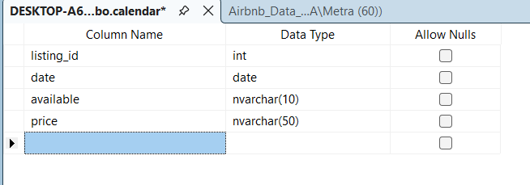
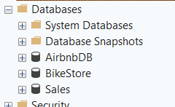
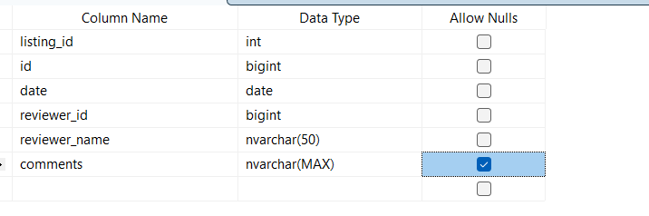
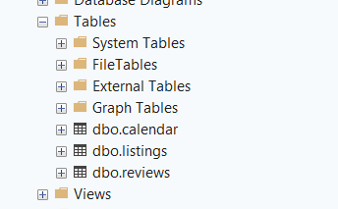
SQL Turns Rows into Business Signals
DATA DIVAS
Airbnb Business Data Analysis

Slide 4
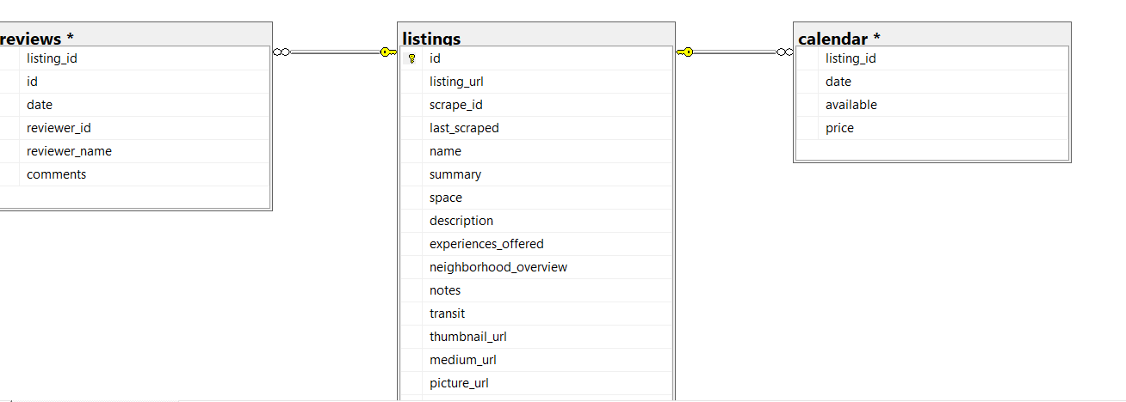
SQL Turns Rows into Business Signals
DATA DIVAS
Airbnb Business Data Analysis

Slide 5
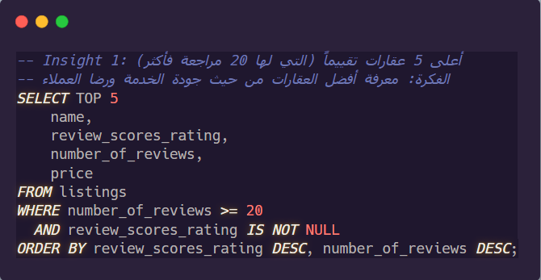
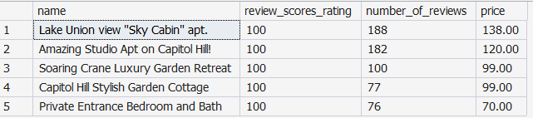
SQL Turns Rows into Business Signals
DATA DIVAS
Airbnb Business Data Analysis

Slide 6
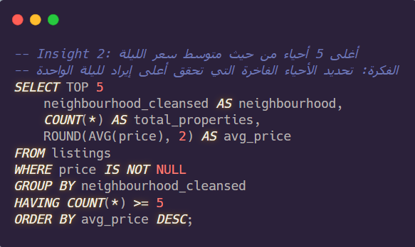
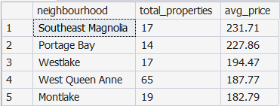
SQL Turns Rows into Business Signals
DATA DIVAS
Airbnb Business Data Analysis

Slide 7
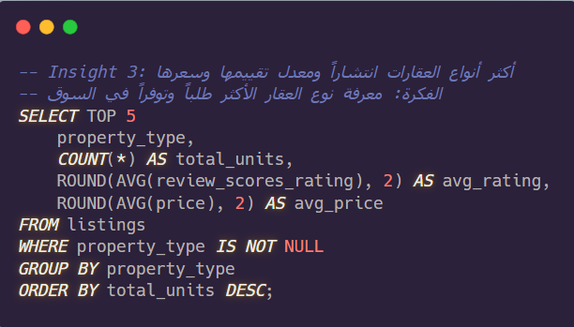
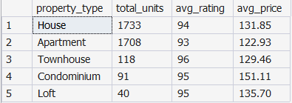
SQL Turns Rows into Business Signals
DATA DIVAS
Airbnb Business Data Analysis

Slide 8
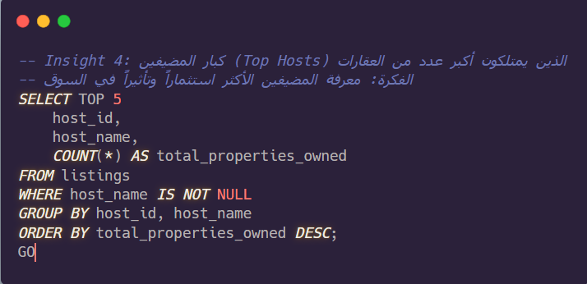
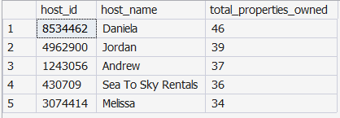
SQL Turns Rows into Business Signals
DATA DIVAS
Airbnb Business Data Analysis

Slide 9
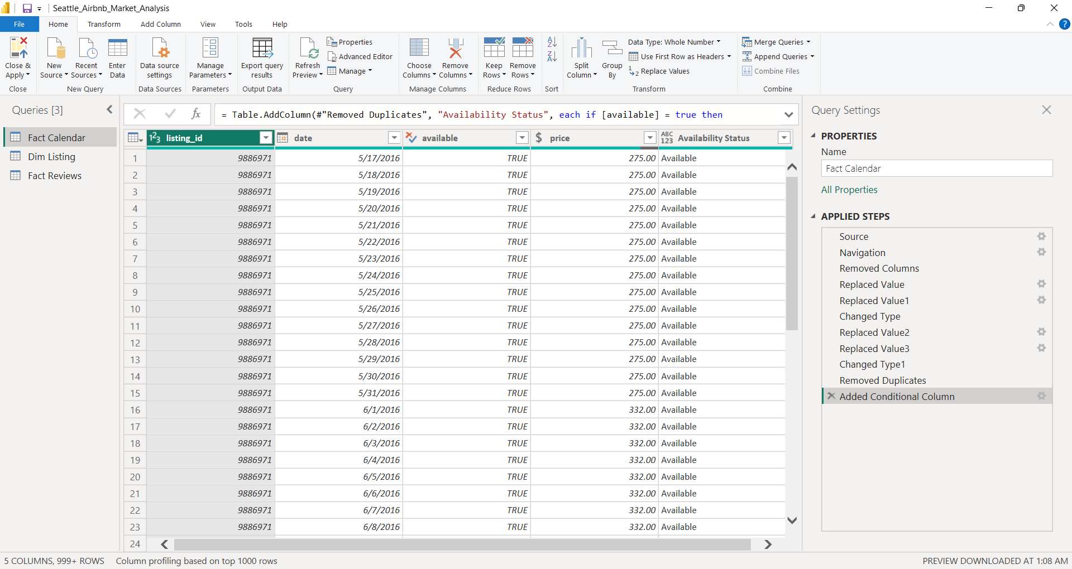
Building the Analytical Engine
Query View
Calendar Data Cleaning
Removed the unnecessary merged listings column
Cleaned availability value by Replace Values (t/f → True/False)
Converted prices to currency format by Replace Values
Corrected ID and date data types
Removed duplicate listing-date records
Add Conditional Column
DATA DIVAS
Airbnb Business Data Analysis

Slide 10
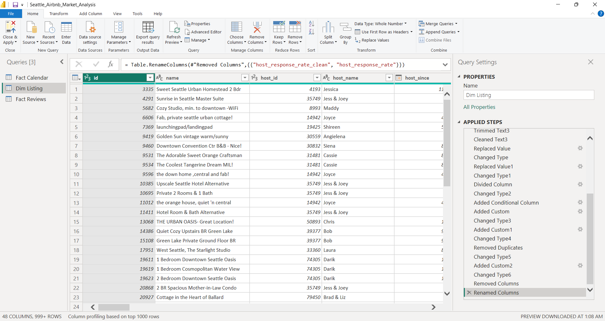
Building the Analytical Engine
Query View
Listings Data Cleaning
Kept only columns needed for analysis
Removed URLs, long descriptions, and unused fields
Clean text columns by Trim/Clean
Cleaned price, percentage, date, and Boolean fields by Replace Values
Created a review-status field for listings with/without reviews
Handled missing values and removed duplicate listings
DATA DIVAS
Airbnb Business Data Analysis

Slide 11
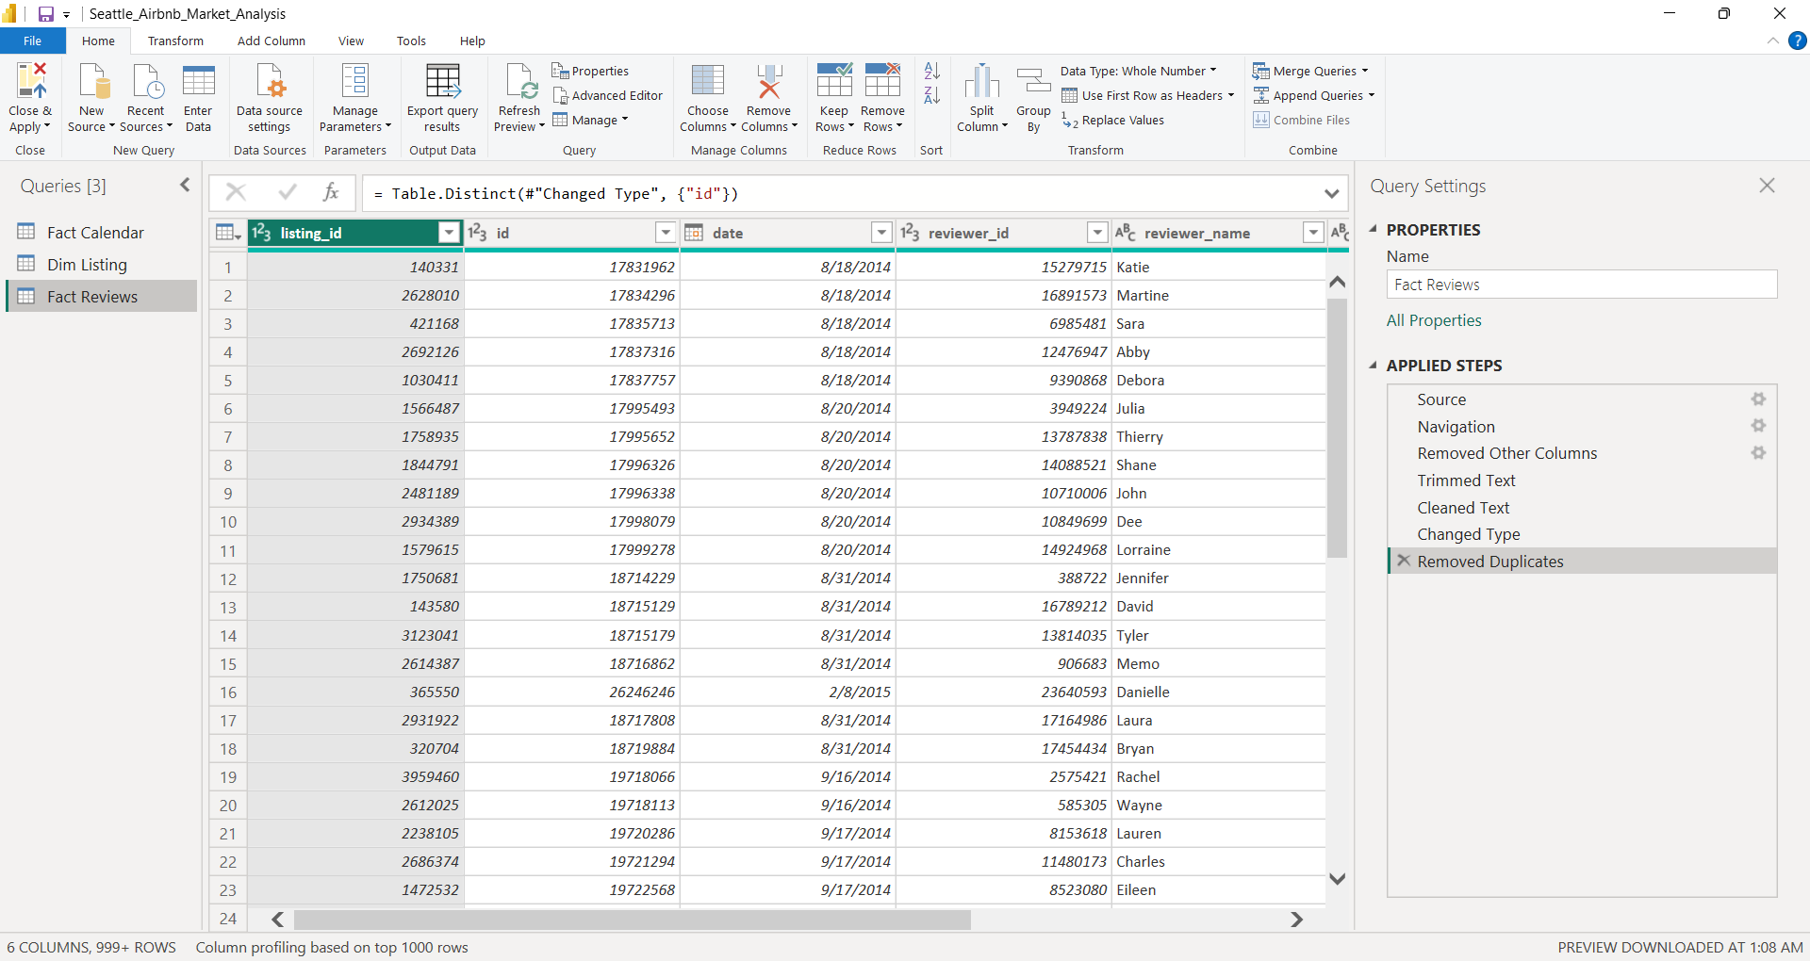
Building the Analytical Engine
Query View
Reviews Data Cleaning
Kept review ID, listing ID, date, reviewer, and comments
Corrected numeric and date data types
Clean reviewer_name & comments by Clean/Trim
Cleaned text fields and removed duplicates
DATA DIVAS
Airbnb Business Data Analysis

Slide 12
Building the Analytical Engine
DAX MEASURES - Creating the Date table
Dim Date
= ADDCOLUMNS (
CALENDAR (
MIN ( 'Fact Reviews'[date] ),
MAX ( 'Fact Calendar'[date] )
),
"Year", YEAR ( [Date] ),
"Month Number", MONTH ( [Date] ),
"Month", FORMAT ( [Date], "MMMM" ),
"Quarter", "Q" & FORMAT ( [Date], "Q" ),
"Year-Month", FORMAT ( [Date], "YYYY-MM" )
)
DATA DIVAS
Airbnb Business Data Analysis

Slide 13
Building the Analytical Engine
DATA MODEL
DAX MEASURES (11 measures)
Star Schema
Availability Rate
Dim Date
(date)
= DIVIDE ( [Available Days], [Available Days] + [Unavailable Days] )
Available Days
Fact Calendar
(listing_id)
Fact Reviews
(listing_id)
= CALCULATE (
COUNTROWS ( 'Fact Calendar' ),
'Fact Calendar'[available] = TRUE ())
Average Available Nightly Price
Dim Listing
(ID)
= CALCULATE (
AVERAGE ( 'Fact Calendar'[price] ),
'Fact Calendar'[available] = TRUE ())
Average Listing Price
= AVERAGE ( 'Dim Listing'[price] )
DATA DIVAS
Airbnb Business Data Analysis

Slide 14
Building the Analytical Engine
DAX MEASURES
DAX MEASURES
Total Listings
Average Rating
= DISTINCTCOUNT ( 'Dim Listing'[id] )
= AVERAGE ( 'Dim Listing'[review_scores_rating] )
Total Reviews
Reviews per Listing
= COUNTROWS ( 'Fact Reviews' )
= DIVIDE ( [Total Reviews], [Total Listings] )
Unavailable Days
= CALCULATE (
COUNTROWS ( 'Fact Calendar' ),
'Fact Calendar'[available] = FALSE ())
Superhost Listings
= CALCULATE (
[Total Listings],
'Dim Listing'[host_is_superhost] = TRUE ())
Superhost Rate
DIVIDE ( [Superhost Listings], [Total Listings] )
DATA DIVAS
Airbnb Business Data Analysis

Slide 15
Turning Insights into Action
THANK YOU!
Data → Insights → Decisions
Data Divs
SQL • Power BI • Business Analytics

